Slide 1



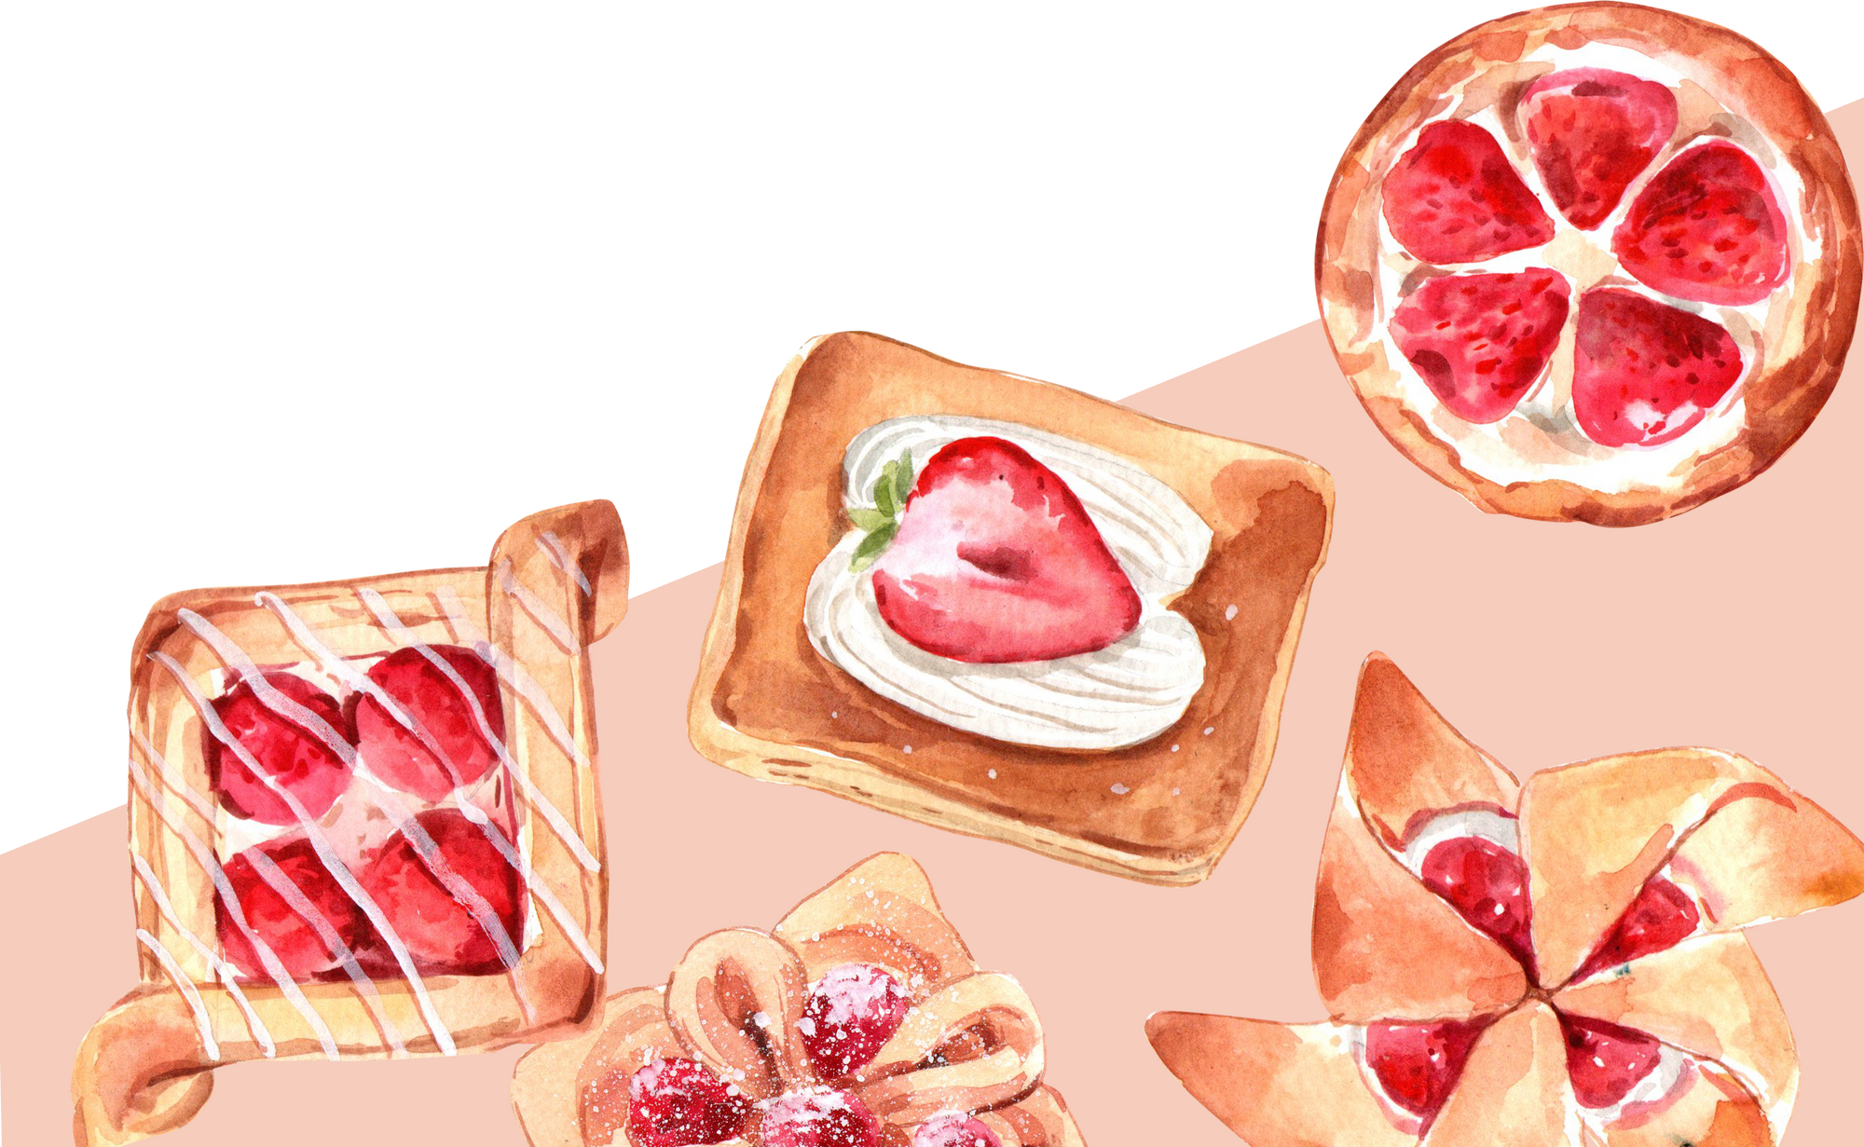
Sweet
Match
Peyton Wesley IS 3020 W01
Got Room for Dessert?
**code output from SweetMatch program**
SweetMatch, a Personalized Dessert Recommender Based on Mood & Flavor.
Hello! How are you feeling today?
Select your mood (or press q to quit):
a.happy
b.sad/stressed
c.cozy/romantic
d.adventurous
What flavor are you craving?:
a.chocolate
b.fruity
c.creamy
Since you're feeling cozy/romantic, and craving something chocolate , here are some desserts!
How about: Black Forest Cake?
Do you like this suggestion?(y/n)y
Enjoy your treat!
Mood input Flavor choice Dessert Recommendation

